Slide 1


Slide 2

GYM The Lion

Slide 3
Problem Statement

Slide 4
Because there is no available and equipped place for sports and the lack of equipment that helps to do sports.🏋️‍♀️

Slide 5
Brief About The Project

Slide 6
GYM PROJECT is building a culture of health, engagement and connection to help people transform their lives inside and out of the gym. We believe there’s power in purpose; acting with intentional focus on a desired outcome. Combining community causes with exercise offers people greater purpose than personal health alone;
it offers fitness for the whole self—mind, body and soul. The result? Fulfillment in ourselves, strength in our communities.

Slide 7
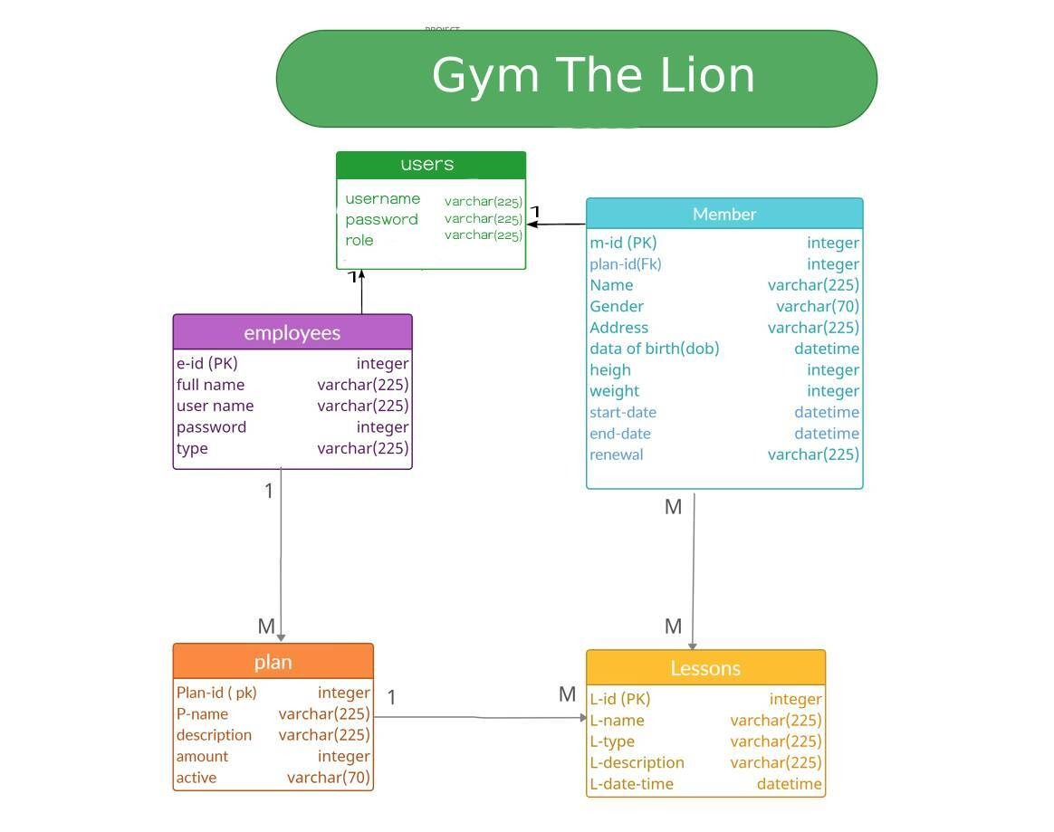
ERD GYM The Lion

Slide 8
Demo Of the Project

Slide 9
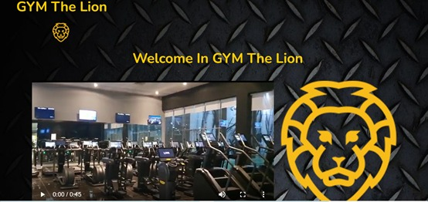
1- Home Page
1
This page is the top of the home page with a video explaining the gyms .

Slide 10

1- Home Page
2
This page is part of the home page and contains two windows Join us and the login window

Slide 11
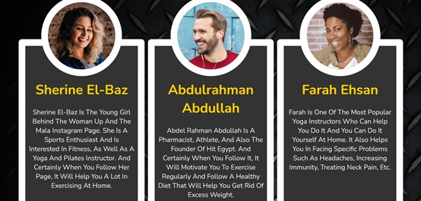
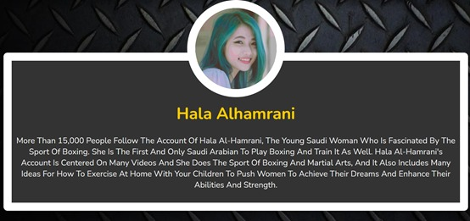
1- Home Page
3
This page is also part of the home page and contains a brief about the trainers in Gym The Lion.
4

Slide 12
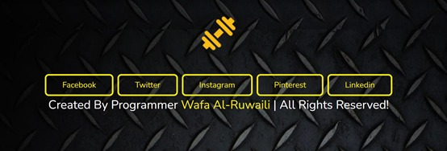
1- Home Page
5
It is the last part of the home page and contains windows for gym accounts on social media

Slide 13
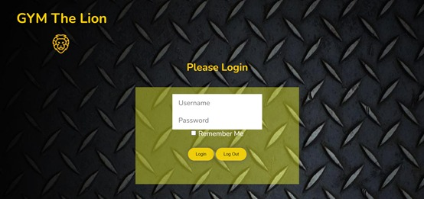
2- Login Window
1
After registering the member or employee, he can access his page on the gym website through this window

Slide 14
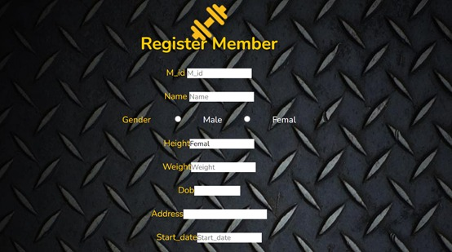
3- Member Registration .
1
This is the member registration window.

Slide 15
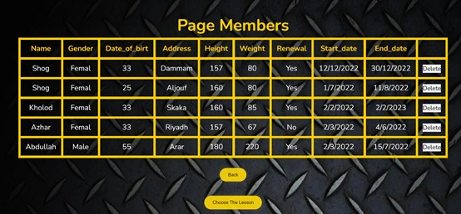
4- Page Member .
1
After the member is registered and confirmed, he goes to the data display page, where he can delete his registration through the delete button, and he can also move to the lesson registration by clicking on the lesson choose button

Slide 16
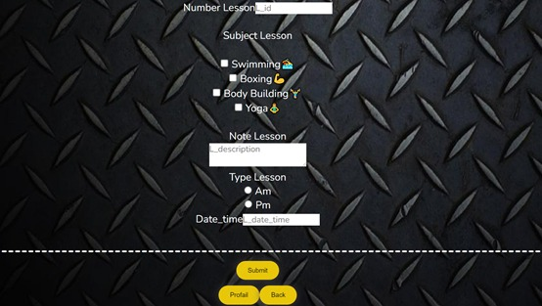
5- This is the lessons registration page.
1

Slide 17
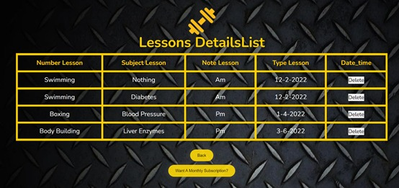
6- lesson registration page.
1
On this page, the member finds the lesson he chose, and he can delete the lesson, or he wants to go to the subscriptions page .

Slide 18
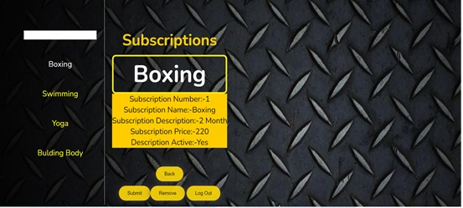
7- Subscriptions and plans page.
1
This is the subscriptions and plans added by the trainer page, which includes the duration of the subscription, the name of the lesson and its price .

Slide 19
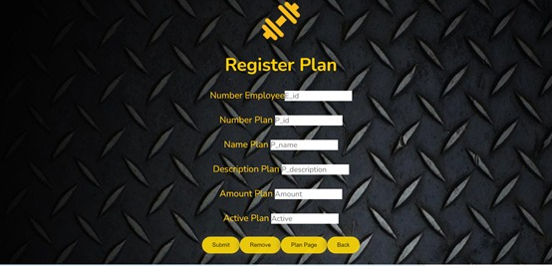
8- Plan to a lessons page.
1
From here, the coach can add the
plan to a lesson

Slide 20
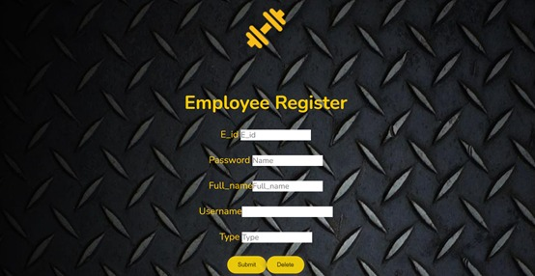
9- Employee registration page .
1

Slide 21
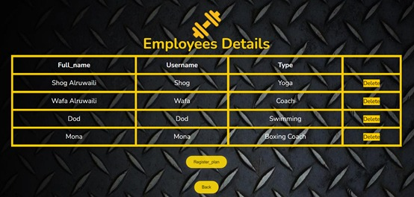
10- Employee's data page .
1
The employee's data page, where he can delete his account

Slide 22
Technologies used

Slide 23



1- Visual Studio Code.
2- Postman.
3- MySQL Shell.

Slide 24



4- IntelliJ IDEA Community Edition 2021.2.3.
5- spring.
6- Heroku.

Slide 25
The programming languages used
Back End: Database (MySQL).
Front End: React .
Connect the backend and frontend through the API .
(Application Programming Interface)

Slide 26
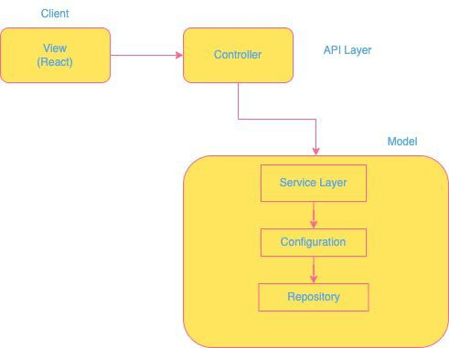
The programming languages used
And used the MVC design pattern

Slide 27
Most difficult part of the project

Slide 28
The most difficult part of the project foreign key .

Slide 29
My favorite part of the project

Slide 30
The best part is the Cascading Style Sheets (CSS) .

Slide 31
The new things you learned creating this application

Slide 32
The database is not static, as is the local storage .

Slide 33
Reference
https://satr.codes/list/courses
https://reactrouter.com/
https://www.w3schools.com/

Slide 34
Prepared by programmer: Wafa Al-Ruwaili🌺

Slide 35


